Slide 1
4
INTEGRALS
Copyright © Cengage Learning. All rights reserved.

Slide 2
Integration Strategy
Simplify the integrand, if possible.
See if a “simple” substitution will work.
Identify the type of integral. (rational function, trigonometric function, polynomial times a trig, exponential, or logarithm)
4. Can we relate the integral to an integral we already know how to do?
5. Do we need to use multiple techniques?
6. Try again.

Slide 3
Can we Integrate all
Continuous Functions?

Slide 4



Can we Integrate all Continuous Functions?
Most of the functions that we have been dealing with here are what are called elementary functions.
If f is an elementary function, then f ′ is an elementary function but need not be an elementary function. Consider f (x) = e^{x2}. Since f is continuous, its integral exists, and if we define the function F by
then we know from Part 1 of the Fundamental Theorem of Calculus that

Slide 5

Can we Integrate all Continuous Functions?
Thus f (x) = e^{x2} has an antiderivative F, but it can be proved that F is not an elementary function.
This means that no matter how hard we try, we will never succeed in evaluating in terms of the functions we know.

Slide 6
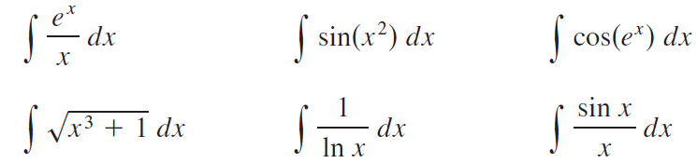
Can we Integrate all Continuous Functions?
The same can be said of the following integrals:
In fact, the majority of elementary functions don’t have elementary antiderivatives.

Slide 7
4.8
Numerical Approximate Integration
Copyright © Cengage Learning. All rights reserved.

Slide 8

Numerical Approximate Integration
There are two situations in which it is impossible to find the exact value of a definite integral.
The first situation arises from the fact that in order to find using the Evaluation Theorem we need to know an antiderivative of f.
Sometimes, however, it is difficult, or even impossible, to find an antiderivative.

Slide 9
Numerical Approximate Integration
The second situation arises when the function is determined from a scientific experiment through instrument readings or collected data.
There may be no formula for the function. In both cases we need to find approximate values of definite integrals.

Slide 10

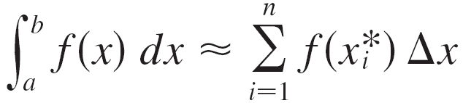


Numerical Approximate Integration
We know that the definite integral is defined as a limit of Riemann sums, so any Riemann sum could be used as an approximation to the integral:
If we divide [a, b] into n subintervals of equal length then we have
where is any point in the ith subinterval

Slide 11

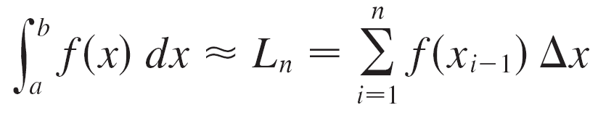



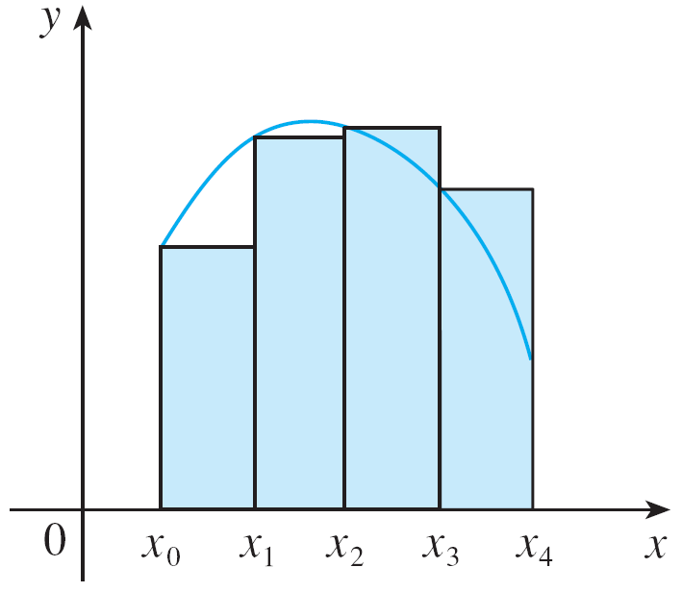
Left Point Rule
If is chosen to be the left endpoint of the interval, then and we have
If then the integral represents an area and
represents an approximation of this area by the rectangles
shown in Figure 1(a).
Figure 1(a)
Left end point approximation

Slide 12

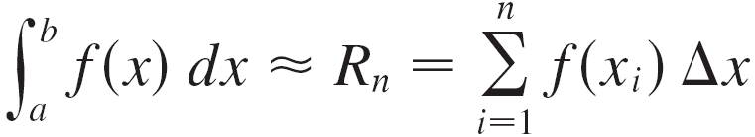

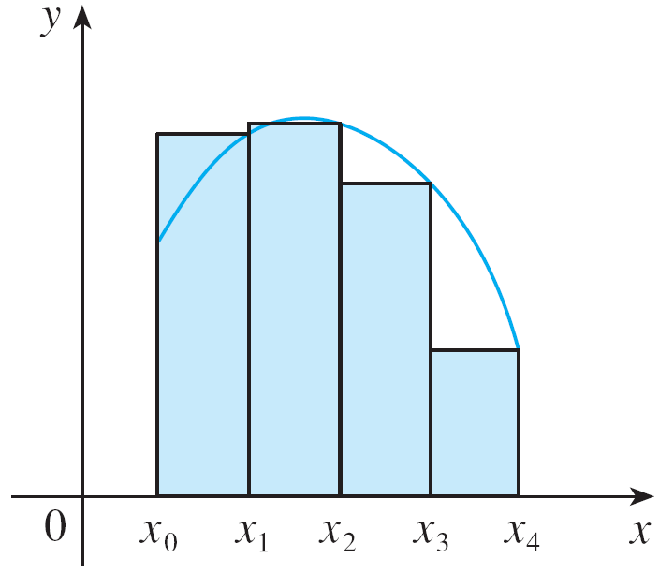
Right Point Rule
If we choose to be the right endpoint, then and we have
[See Figure 1(b).]
The approximations L_{n} and R_{n} defined by Equations 1 and 2 can also be called as left endpoint approximation and right endpoint approximation, respectively.
Figure 1(b)
Right end point approximation

Slide 13

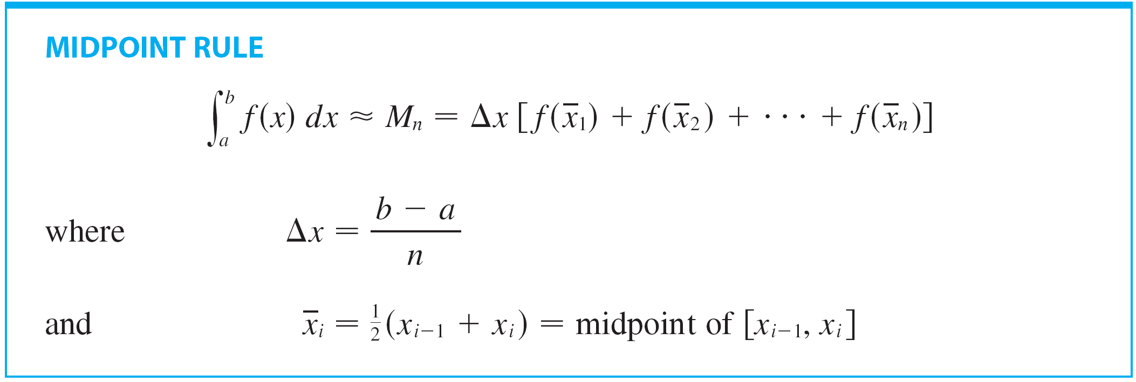
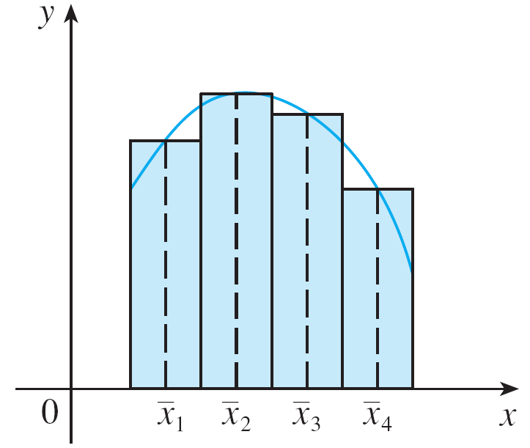
Midpoint Rule
We also considered the case where is chosen to be the midpoint of the subinterval
Figure 1(c) shows the midpoint
approximation M_{n}, which appears
to be better than either L_{n} or R_{n}.
Figure 1(c)
Midpoint approximation

Slide 14
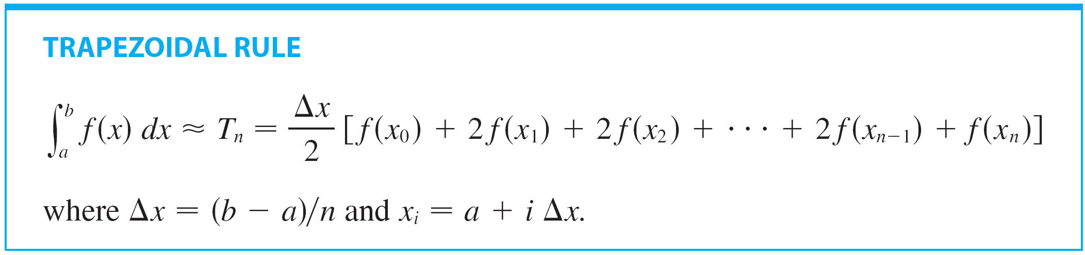
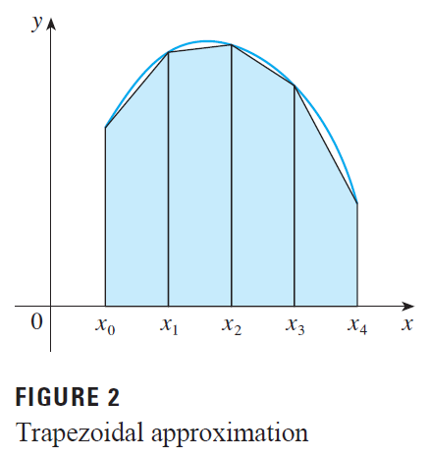
Trapezoidal Rule
Another approximation, called the Trapezoidal Rule, results from averaging the approximations in Equations 1 and 2:

Slide 15


Example 1
Use (a) the Trapezoidal Rule and
(b) the Midpoint Rule
with n = 5 to approximate the integral
Solution:
(a) With n = 5, a = 1, and b = 2, we have
and so the Trapezoidal Rule gives

Slide 16
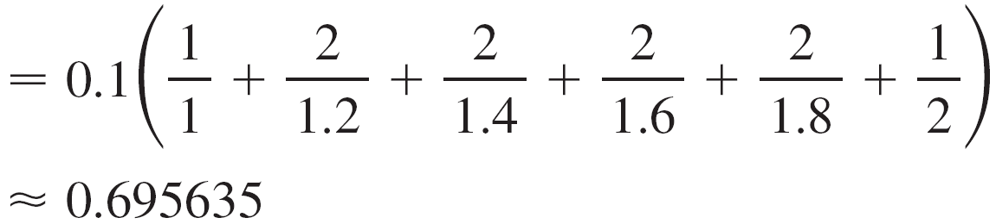
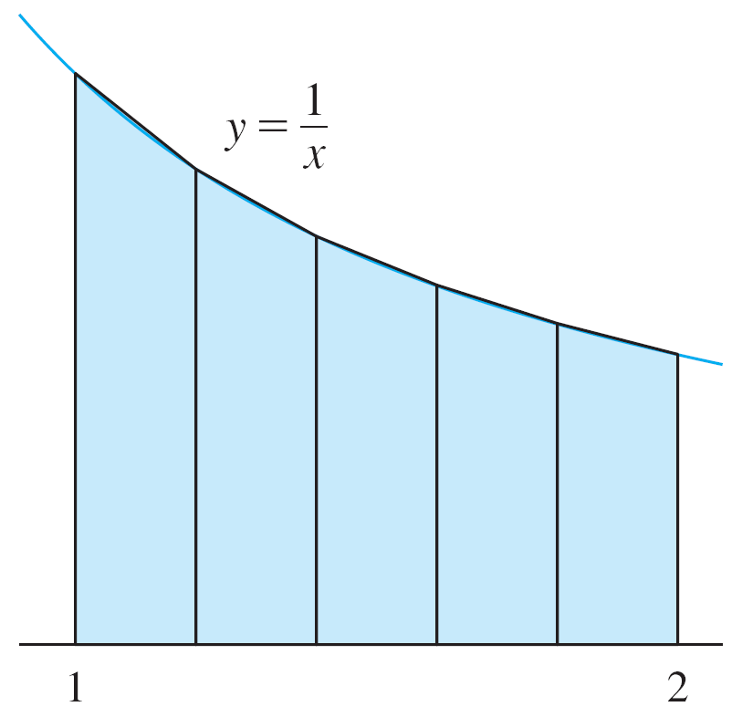
Example 1 – Solution
cont’d
This approximation is illustrated
in Figure 3.
Figure 3

Slide 17
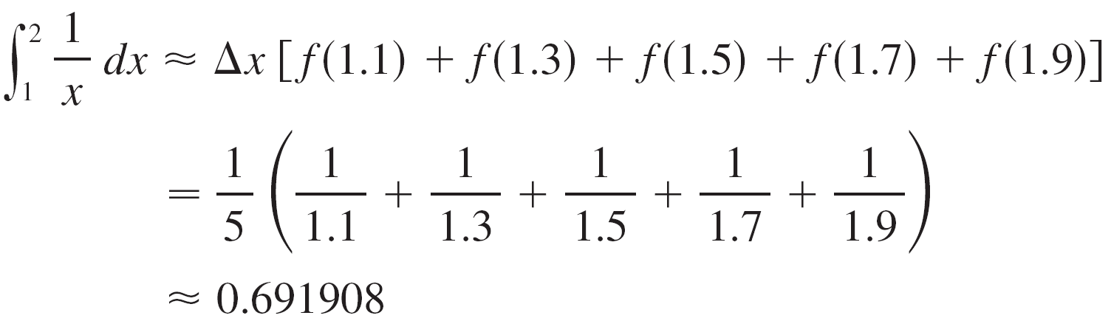
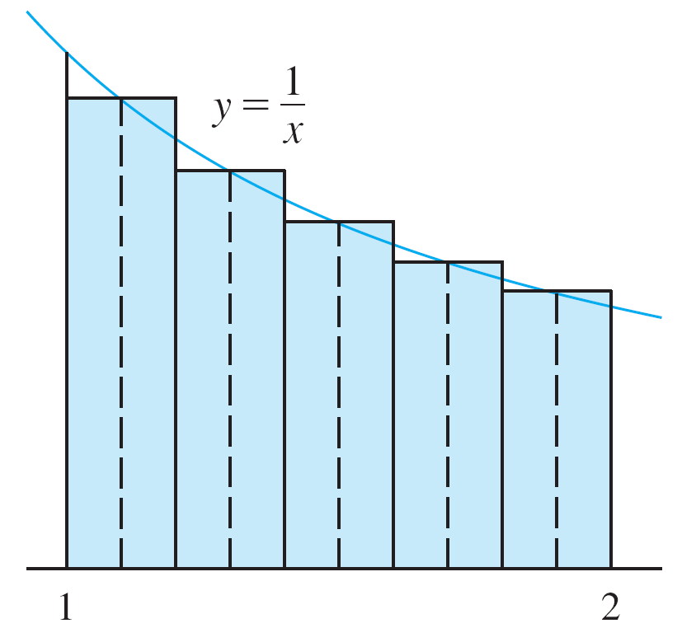
Example 1 – Solution
cont’d
(b) The midpoints of the five subintervals are 1.1, 1.3, 1.5, 1.7, and 1.9, so the Midpoint Rule gives
This approximation is illustrated
in Figure 4.
Figure 4

Slide 18
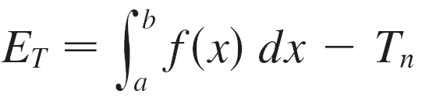
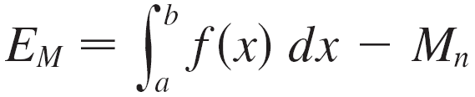
Numerical Approximate Integration
The error in using an approximation is defined to be the amount that needs to be added to the approximation to make it exact.
In general, we have
and

Slide 19
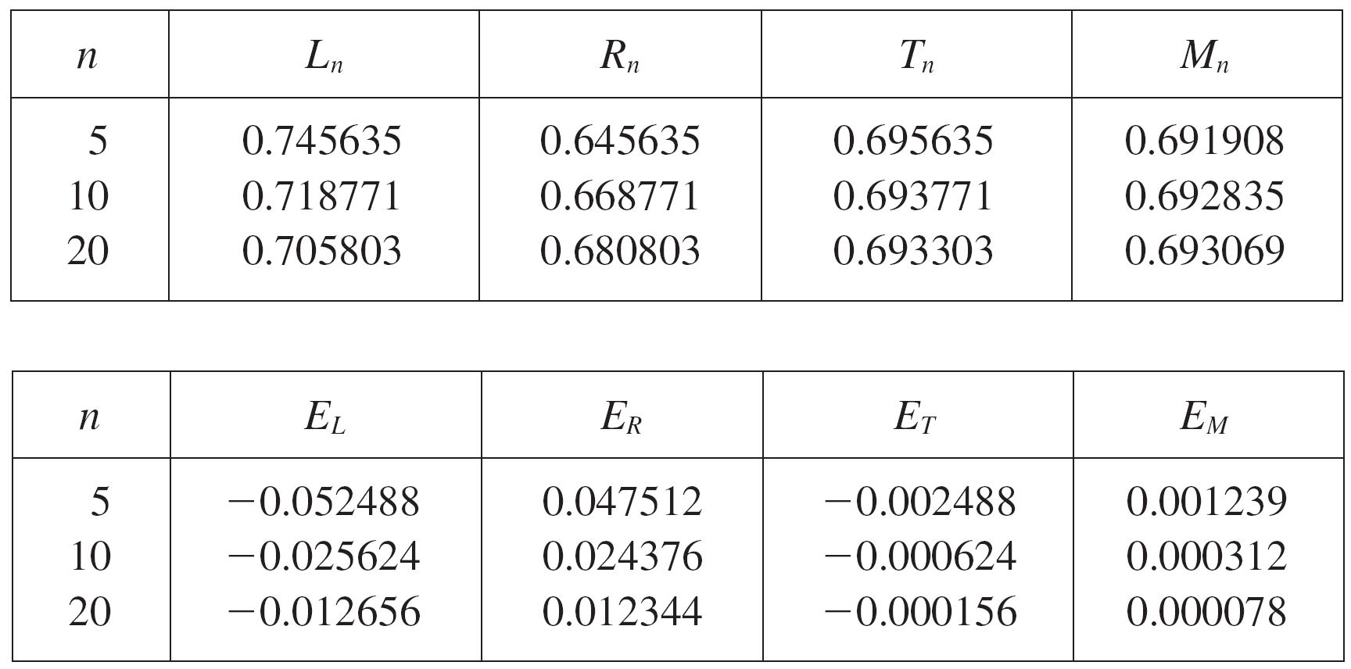
Numerical Approximate Integration
The following tables show the results of calculations similar to those in Example 1, but for n = 5, 10, and 20 and for the left and right endpoint approximations as well as the Trapezoidal and Midpoint Rules.

Slide 20
Numerical Approximate Integration
We can make several observations from these tables:
1. In all of the methods we get more accurate
approximations when we increase the value of n. (But
very large values of n result in so many arithmetic
operations that we have to beware of accumulated
round-off error.)
2. The errors in the left and right endpoint approximations
are opposite in sign and appear to decrease by a factor
of about 2 when we double the value of n.

Slide 21
Numerical Approximate Integration
3. The Trapezoidal and Midpoint Rules are much more accurate than the endpoint approximations.
4. The errors in the Trapezoidal and Midpoint Rules are opposite in sign and appear to decrease by a factor of about 4 when we double the value of n.
5. The size of the error in the Midpoint Rule is about half the size of the error in the Trapezoidal Rule.

Slide 22
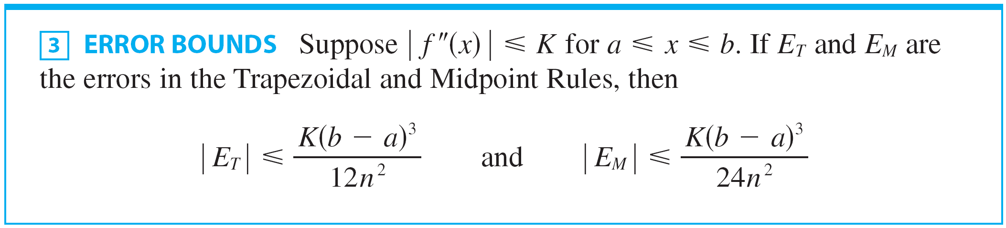
Numerical Approximate Integration
Following is the errors estimate for the Trapezoidal and Midpoint Rules:

Slide 23





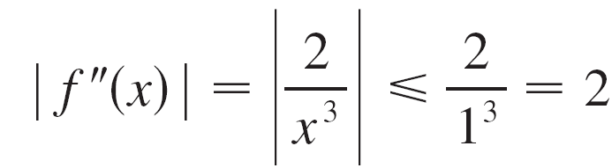

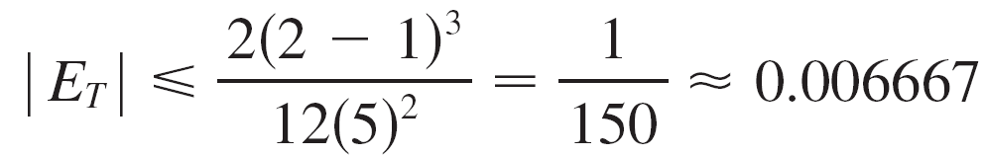
Numerical Approximate Integration
Let’s apply this error estimate to the Trapezoidal Rule approximation in Example 1.
If then and
Since we have so
Therefore, taking K = 2, a = 1, b = 2 and n = 5 in the error estimate , we see that

Slide 24



Example 2
How large should we take n in order to guarantee that the Trapezoidal and Midpoint Rule approximations for are accurate to within 0.0001?
Solution:
We saw in the preceding calculation that for
so we can take K = 2, a = 1, and b = 2 in .
Accuracy to within 0.0001 means that the size of the error should be less than 0.0001.

Slide 25
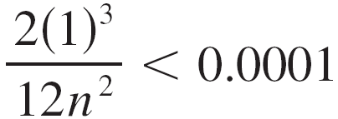
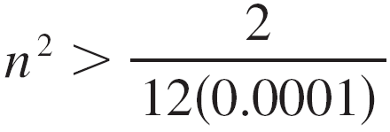
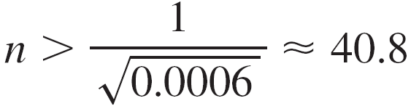
Example 2 – Solution
cont’d
Therefore we choose n so that
Solving the inequality for n, we get
or
Thus n = 41 will ensure the desired accuracy.

Slide 26
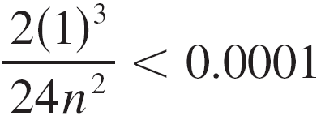
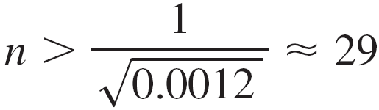
Example 2 – Solution
cont’d
For the same accuracy with the Midpoint Rule we choose n so that
which gives

Slide 27
Simpson’s Rule

Slide 28

Simpson’s Rule
Another rule for approximate integration results from using parabolas instead of straight line segments to approximate a curve.
As before, we divide [a, b] into n subintervals of equal length but this time we assume that n is an even number.

Slide 29

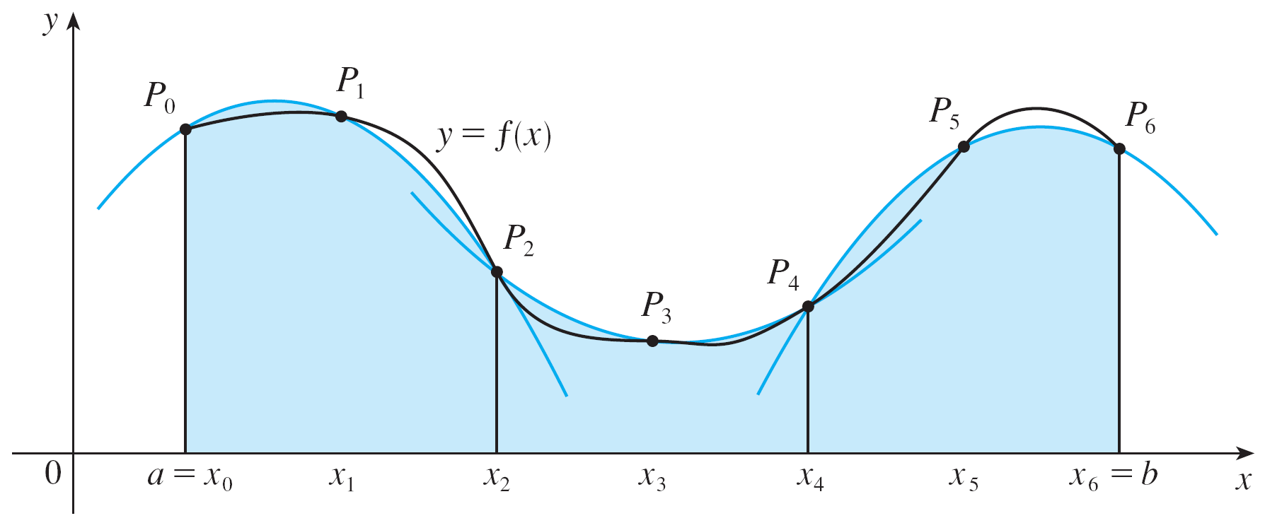
Simpson’s Rule
Then on each consecutive pair of intervals we approximate the curve by a parabola as shown in Figure 7.
Figure 7

Slide 30
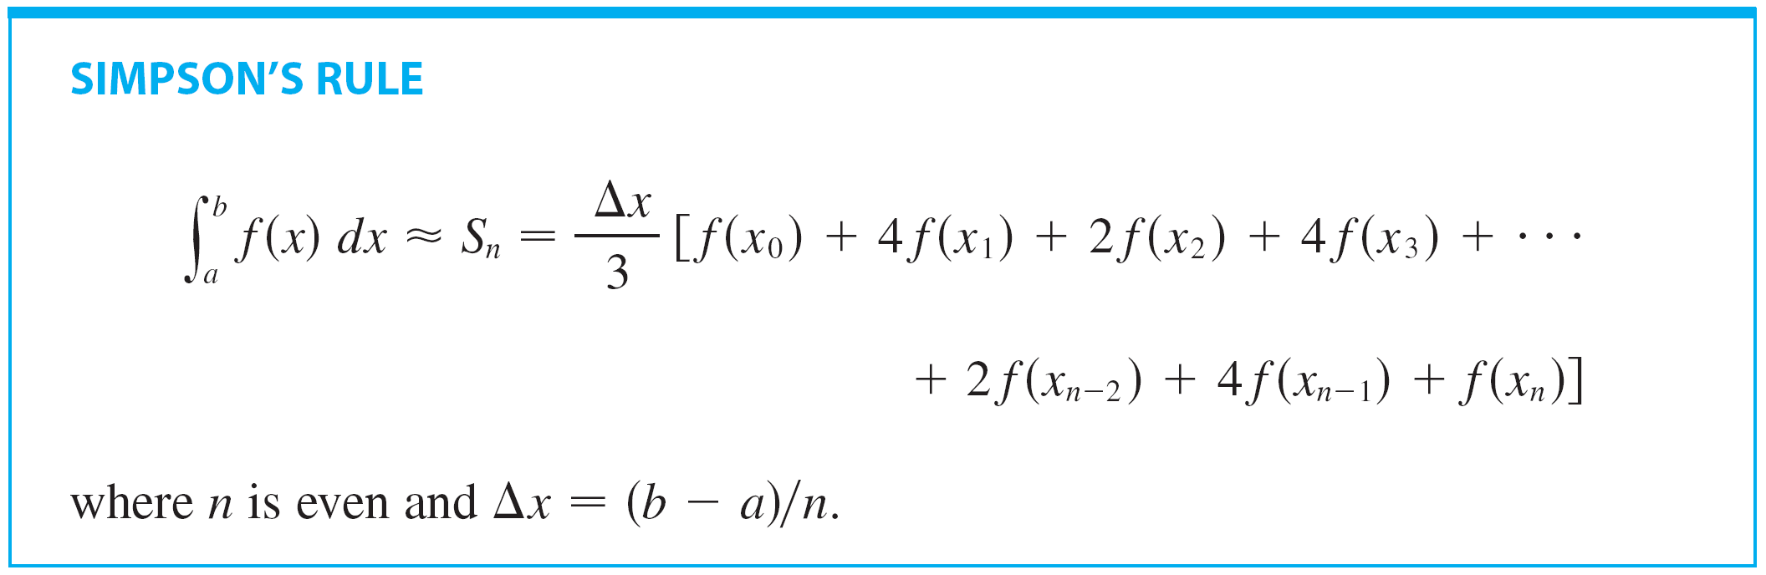
Simpson’s Rule
Following is the another approximation, called Simpson’s Rule, note the pattern of coefficients: 1, 4, 2, 4, 2,..., 4, 2, 4, 1

Slide 31


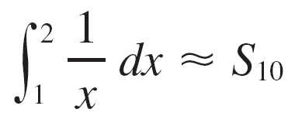
Example 4
Use Simpson’s Rule with n = 10 to approximate
Solution:
Putting f (x) = 1/x, n = 10, and in Simpson’s Rule, we obtain

Slide 32

Example 4 – Solution
cont’d

Slide 33

Simpson’s Rule
Notice that, in Example 4, Simpson’s Rule gives us a much better approximation (S₁₀ ≈ 0.693150) to the true value of the integral (In 2 ≈ 0.693147. . .) than does the Trapezoidal Rule (T₁₀ ≈ 0.693771) or the Midpoint Rule (M₁₀ ≈ 0.692835).
It turns out that the approximations in Simpson’s Rule are weighted averages of those in the Trapezoidal and Midpoint Rules:
(We have known that E_{T} and E_{M} usually have opposite signs and |E_{M}| is about half the size of |E_{T}|.)

Slide 34
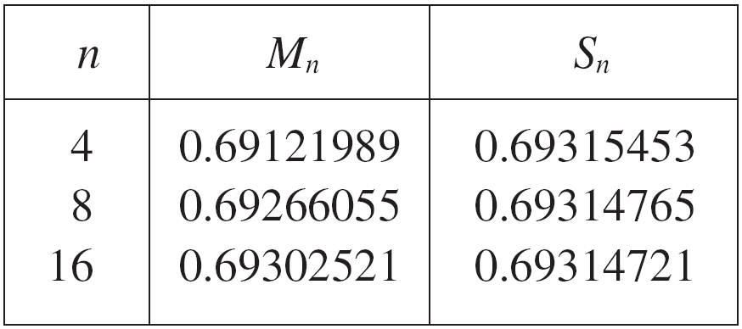

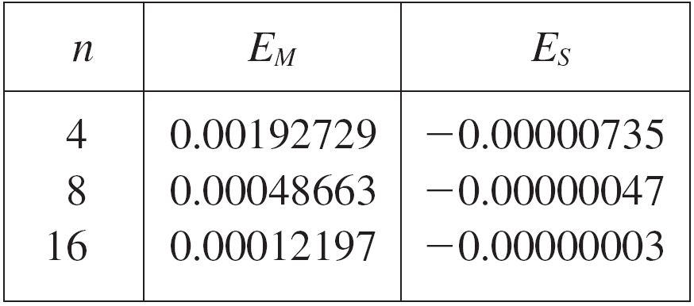
Simpson’s Rule
The table in the right shows
how Simpson’s Rule compares
with the Midpoint Rule for
the integral whose
value is about 0.69314718.
The second table shows how
the error E_{S} in Simpson’s Rule
decreases by a factor of about
16 when n is doubled.

Slide 35
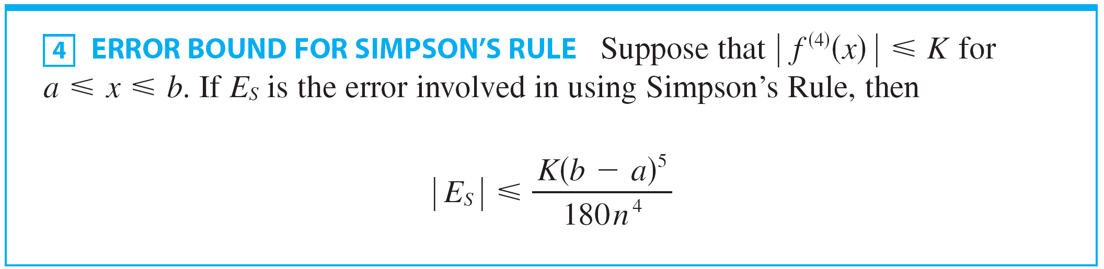
Simpson’s Rule
That is consistent with the appearance of n⁴ in the denominator of the following error estimate for Simpson’s Rule.
It is similar to the estimates given in for the Trapezoidal and Midpoint Rules, but it uses the fourth derivative of f.

Slide 36




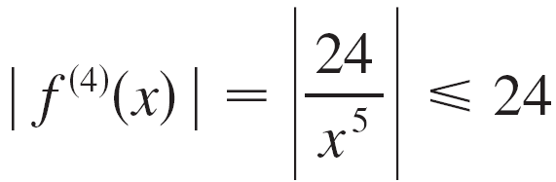
Example 6
How large should we take n in order to guarantee that the Simpson’s Rule approximation for is accurate to within 0.0001?
Solution:
If f (x) = 1/x, then Since we have and so

Slide 37

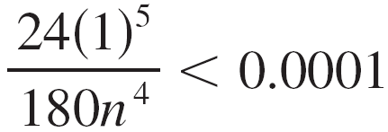
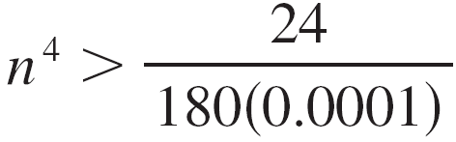
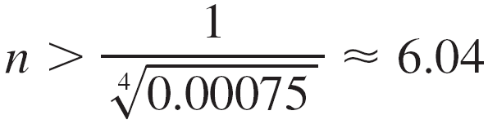
Example 6 – Solution
cont’d
Therefore we can take K = 24 in . Thus for an error less than 0.0001 we should choose n so that
This gives
or
Therefore n = 8 (n must be even) gives the desired accuracy.

